Slide 1
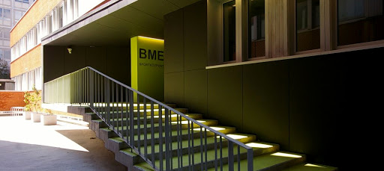
BME Physical Education classes

Slide 2
Physical education classes
  You can choose your sport
  Two semesters obligatory (for full-time degree students)
  Four extra semesters possible (sum of 6 semesters)
  Free or paid classes (approx. 20€/semester)

Slide 3
BME sporting venues
BME Sportközpont (Bertalan Lajos str. 4-6.)
  in English: Sportcenter, Sports Center
BME Sporttelep (Bogdánfy str. 12.)
  in English: Sports field, Sports track
Tüskecsarnok (XI. Magyar tudósok körútja 7.)
  smaller, training courts of the big ice hockey arena
Tüskecsarnok Uszoda (XI. Magyar tudósok körútja 7.)
  next to the big arena, new building

Slide 4
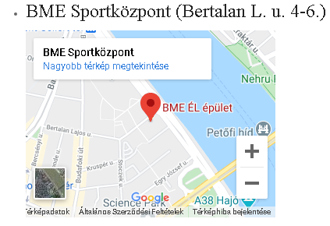
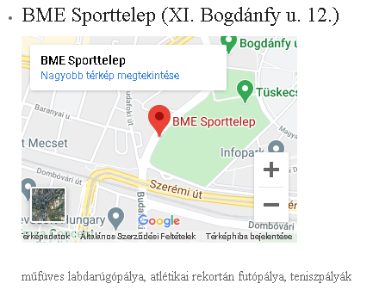
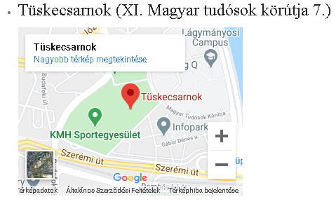
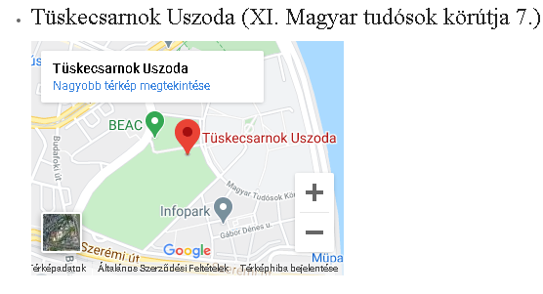

Slide 5
Contact information
www.testneveles.bme.hu
+36-1-463-1197 or +36-1-463-3165
Personal contact: BME Sportközpont (Bertalan Lajos str 4-6.) Office 113

Slide 6
Classes in Neptun System
Obligatory classes:
Physical Education BSc – 1/A
Physical Education BSc - 2/A
Physical Education BSc – 1/B
Physical Education BSc – 2/B
Physical Education BSc – 1/C
Physical Education BSc – 2/C

Slide 7
What does the names mean?
Physical Education BSc – 1/A
Physical Education BSc - 2/A
A stands for the free classes and courses
athletics, soccer, basketball, volleyball

Slide 8
Physical Education BSc – 1/B
Physical Education BSc – 2/B
B stands for the paid classes and courses
6000 Forint/semester (14 occasions)
It has to be paid within the Neptun system

Slide 9
In the following, we list the courses
The naming follows the Neptun convention, so you can find the classes in the system by name
Example: Aerobic (aerobik) – BME Sportközpont (1111 Budapest, Bertalan Lajos u. 4-6.)
  aerobic – Name in English
  (aerobik) – Name in Neptun system (Hungarian)
  BME Sportközpont – Location, in this case the BME Sports Center
In the Neptun system, there are some numbers after the course codes (e.g. falmaszas13, they are the identifiers of the individual groups)

Slide 10
Aerobic (aerobik) – BME Sportközpont (1111 Budapest, Bertalan Lajos u. 4-6.)
Table tennis (asztalitenisz) – BME Sportközpont (1111 Budapest, Bertalan Lajos u. 4-6.)
Box (box) – BME Sportközpont (1111 Budapest, Bertalan Lajos u. 4-6.)
Cross Training (cross training) - BME Sportközpont (1111 Budapest, Bertalan Lajos u. 4-6.)
Weight training – (erofejlesztes) – BME Sportközpont (1111 Budapest, Bertalan Lajos u. 4-6.)
Squash (squash) – BME Sportközpont (1111 Budapest, Bertalan Lajos u. 4-6.)
Bouldering (falmaszas) – BME Sportközpont (1111 Budapest, Bertalan Lajos u. 4-6.)
Functional team traning, within music gymnastics (zenés gimnasztika) – BME Sportközpont (1111 Budapest, Bertalan Lajos u. 4-6.)
Spine training (gerinctrening) – BME Sportközpont (1111 Budapest, Bertalan Lajos u. 4-6.)
Expert swimming (uszas) – Tüskecsarnok Uszoda (XI. Magyar tudósok körútja 7.)
Beginner swimming (uszas-kezdo) – Tüskecsarnok Uszoda (XI. Magyar tudósok körútja 7.)
Yoga (joga) – BME Sportközpont (1111 Budapest, Bertalan Lajos u. 4-6.)
Skating – BME Sporttelep (1111 Budapest, Bogdánfy u. 12.)

Slide 11
Handball – Tüskecsarnok (XI. Magyar tudósok körútja 7.)
Krav maga (krav maga) – BME Sportközpont (1111 Budapest, Bertalan Lajos u. 4-6.)
Folk dance (neptanc) – BME Sportközpont (1111 Budapest, Bertalan Lajos u. 4-6.)
Ricochet (ricochet) – BME Sportközpont (1111 Budapest, Bertalan Lajos u. 4-6.)
Salsa (salsa cubana) – BME Sportközpont (1111 Budapest, Bertalan Lajos u. 4-6.)
Spinning (spinning) ­– BME Sportközpont (1111 Budapest, Bertalan Lajos u. 4-6.)
Partner dance (tarsastanc) – BME Sportközpont (1111 Budapest, Bertalan Lajos u. 4-6.)
Tenis (tenisz) – BME Sporttelep (1111 Budapest, Bogdánfy u. 12.)
Teqball (teqball) – BME Sportközpont (1111 Budapest, Bertalan Lajos u. 4-6.)
Featherball (tollaslabda) – BME Sportközpont (1111 Budapest, Bertalan Lajos u. 4-6.)
TRX (trx) – BME Sportközpont (1111 Budapest, Bertalan Lajos u. 4-6.)

Slide 12
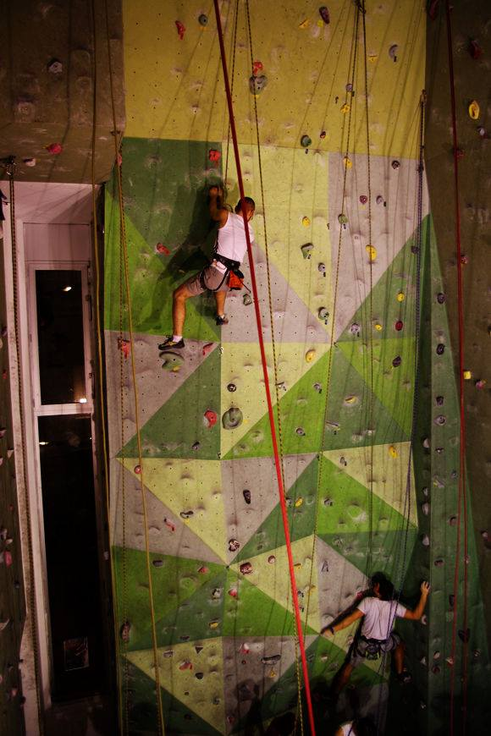
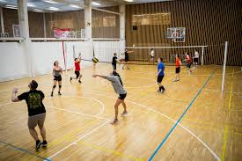
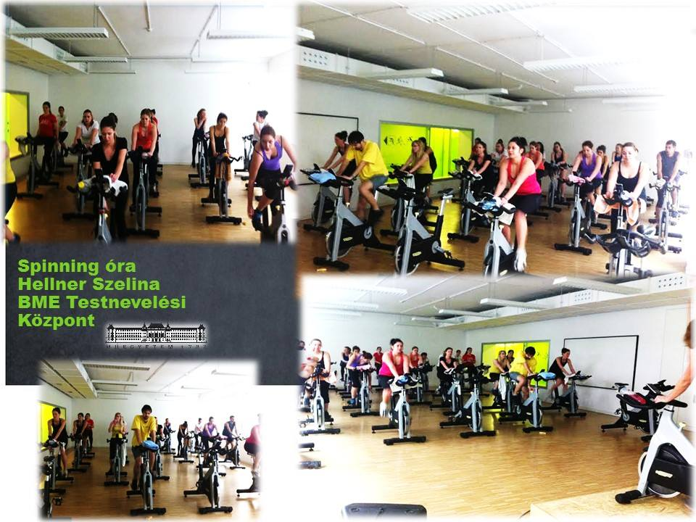
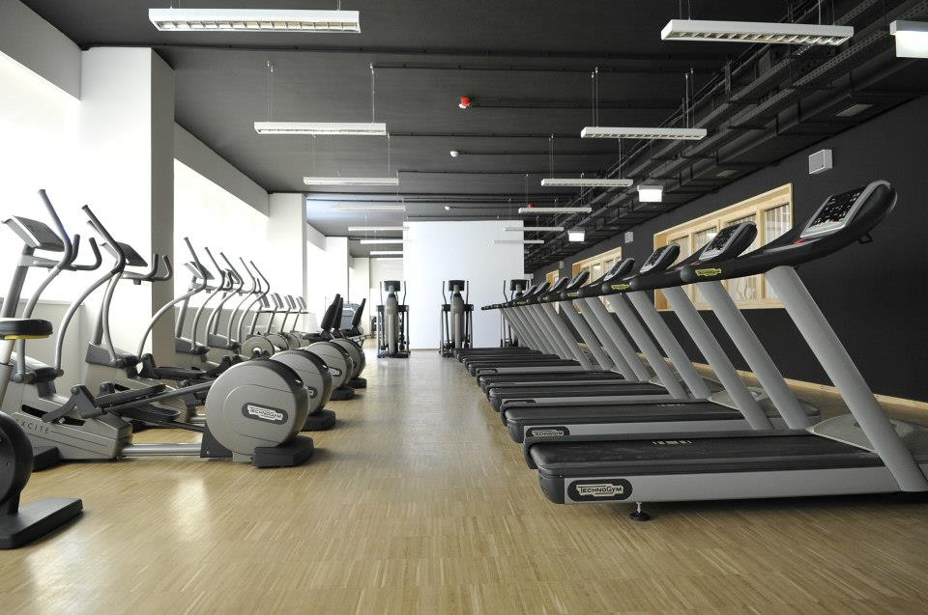
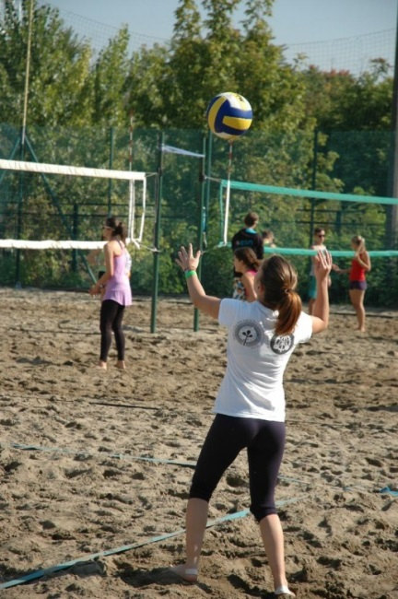
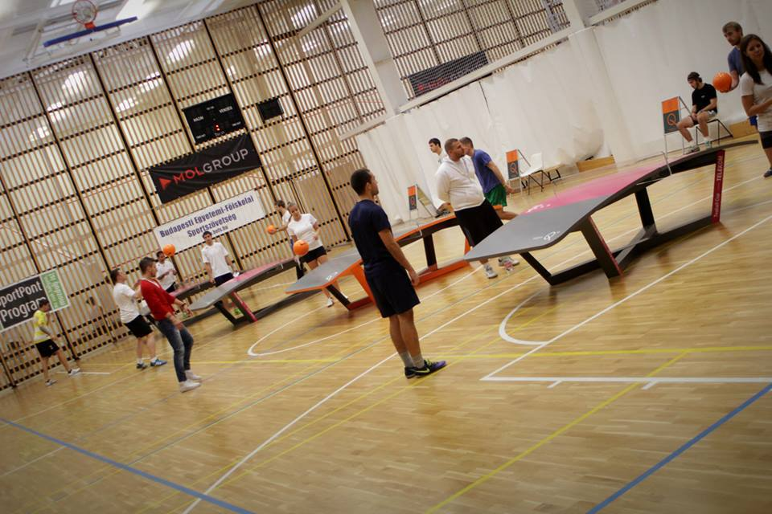
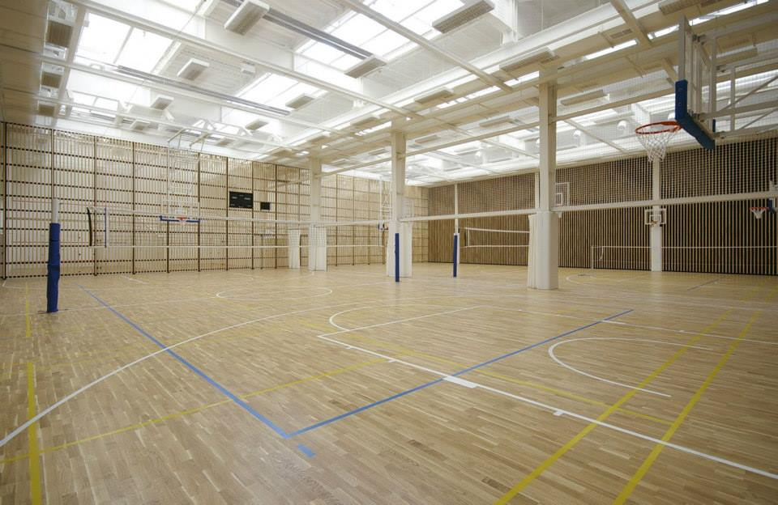
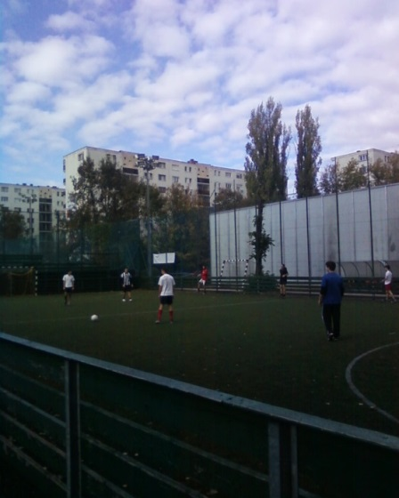
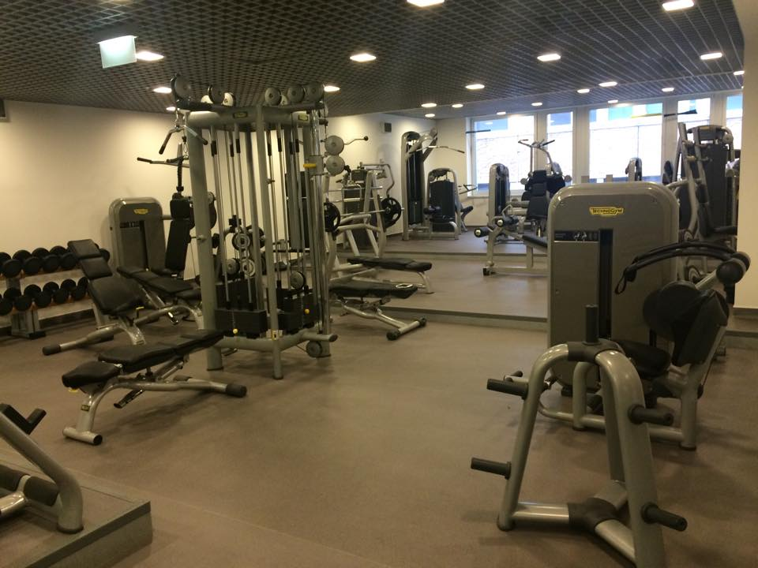
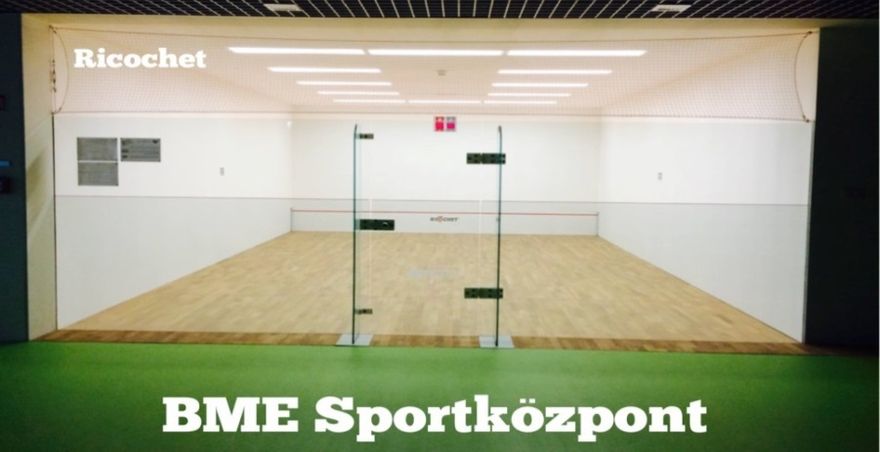

Slide 13
Physical Education BSc – 1/C
Physical Education BSc – 2/C
Exculpations – documents can be found at
https://testneveles.bme.hu/oktatas/nyomtatvanyok
Full exc., for Hungarian national team members
Partial, for players signed to a professional club
Medical

Slide 14
Possibilities after the obligatory semesters
Four extra classes in Neptun
Physical Education – E
Physical Education – F
Physical Education – G
Physical Education - H

Slide 15
Possibilities after the obligatory semesters
Purchase of type B access card in the BME Sports Center
You can try other sports as well
You can join normal classes taking part on workdays in normal PE lessons (8.30-14.30)
6500 forint, includes 16 occasions, you can participate in your own rythm (no obligation, just recommended ☺)

Slide 16
